Slide 1
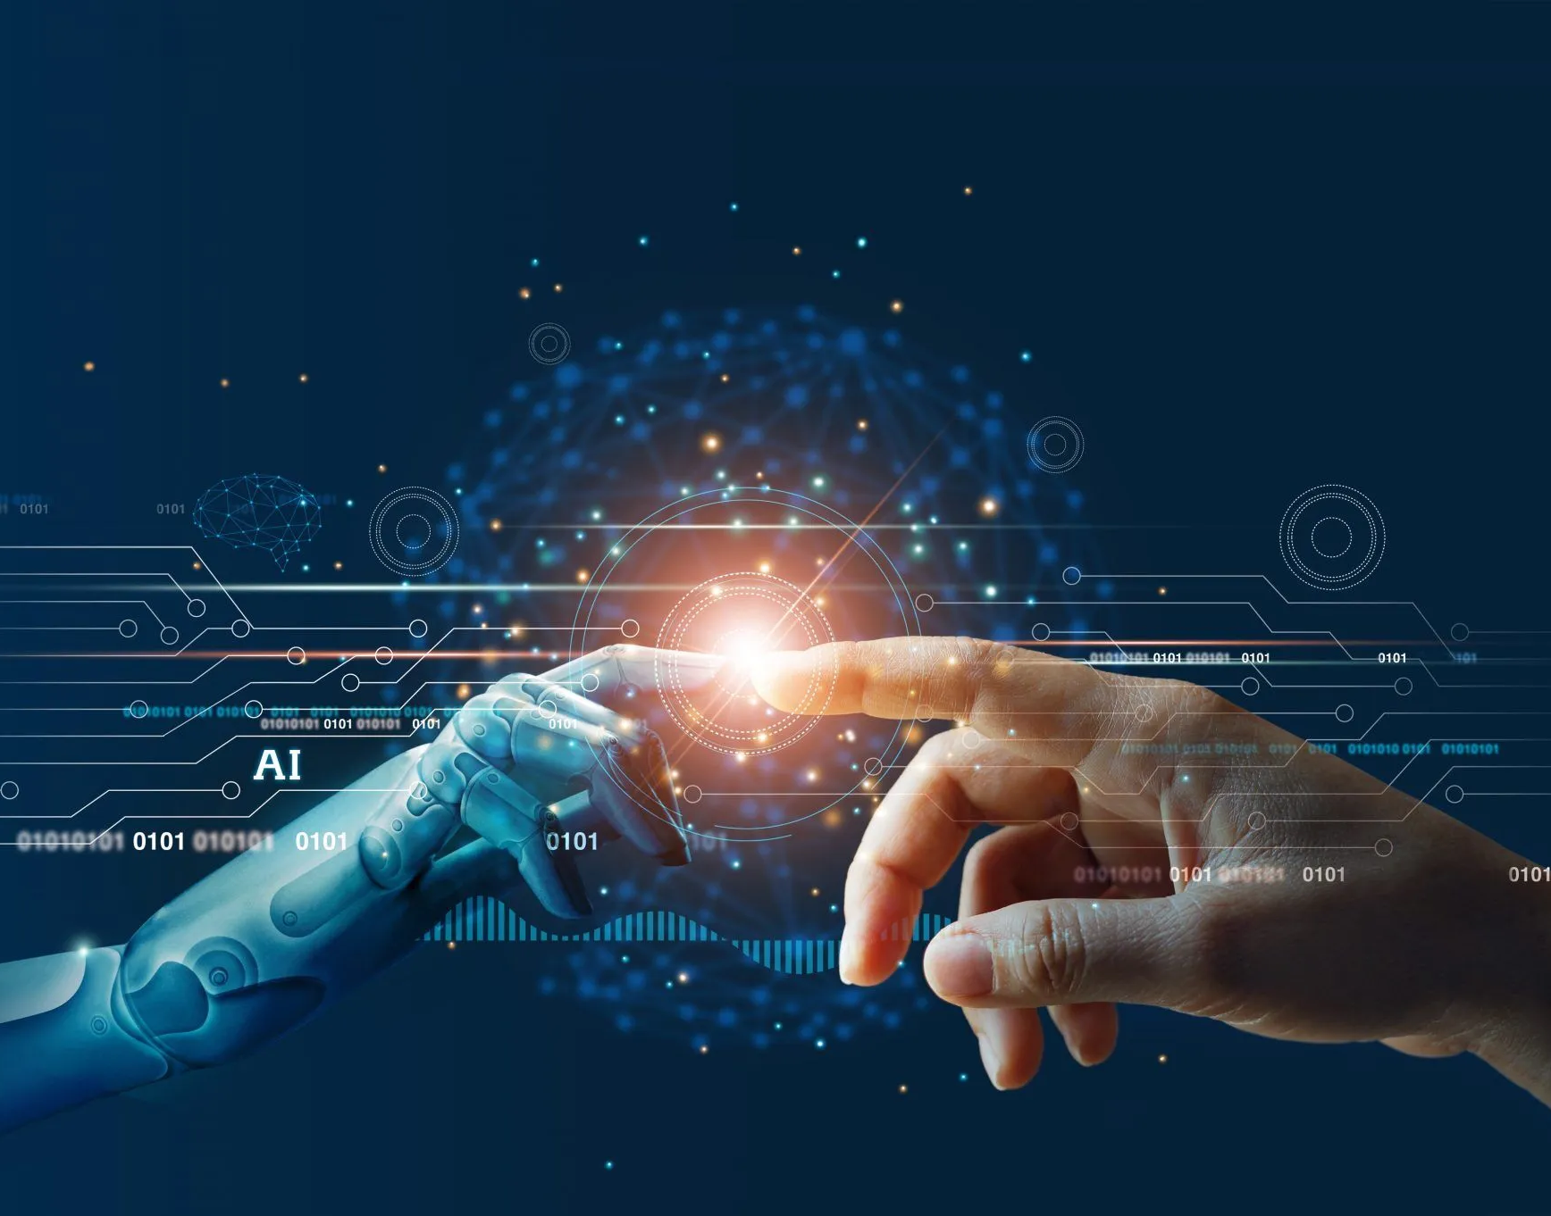
Chat GPT & It’s Capabilities
For RNATE 2k23
By Sandesh Gajendra Pol

Slide 2
Point to be discussed
01 What is Chat GPT
02 Working of Chat GPT
03 Capabilities of chat GPT
04 Current Condition
05 Future of Chat GPT

Slide 3
What is Chat GPT

Slide 4
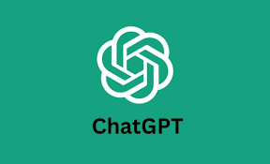
1
ChatGPT is an artificial intelligence (AI) chatbot that uses natural language processing to create humanlike conversational dialogue.
Who created ChatGPT ?
OpenAI , an AI research company created ChatGPT and launched the tool in November 2022.
It was founded by a group of entrepreneurs and researchers including Elon Musk and Sam Altman in 2015

Slide 5
Working of ChatGPT

Slide 6
A prompt is sampled from our prompt dataset
1
Collect and demonstrate data and a supervised policy
2
A labored demonstration the desired output behaver
Steps 1
3
This is used to fine-turn GPT-3.5 with supervised learning

Slide 7
Steps 2
Input Reception
Response Generation
Post-processing.
Text Preprocessing
Output to User.
Model Interaction

Slide 8
Capabilities of Chat GPT

Slide 9


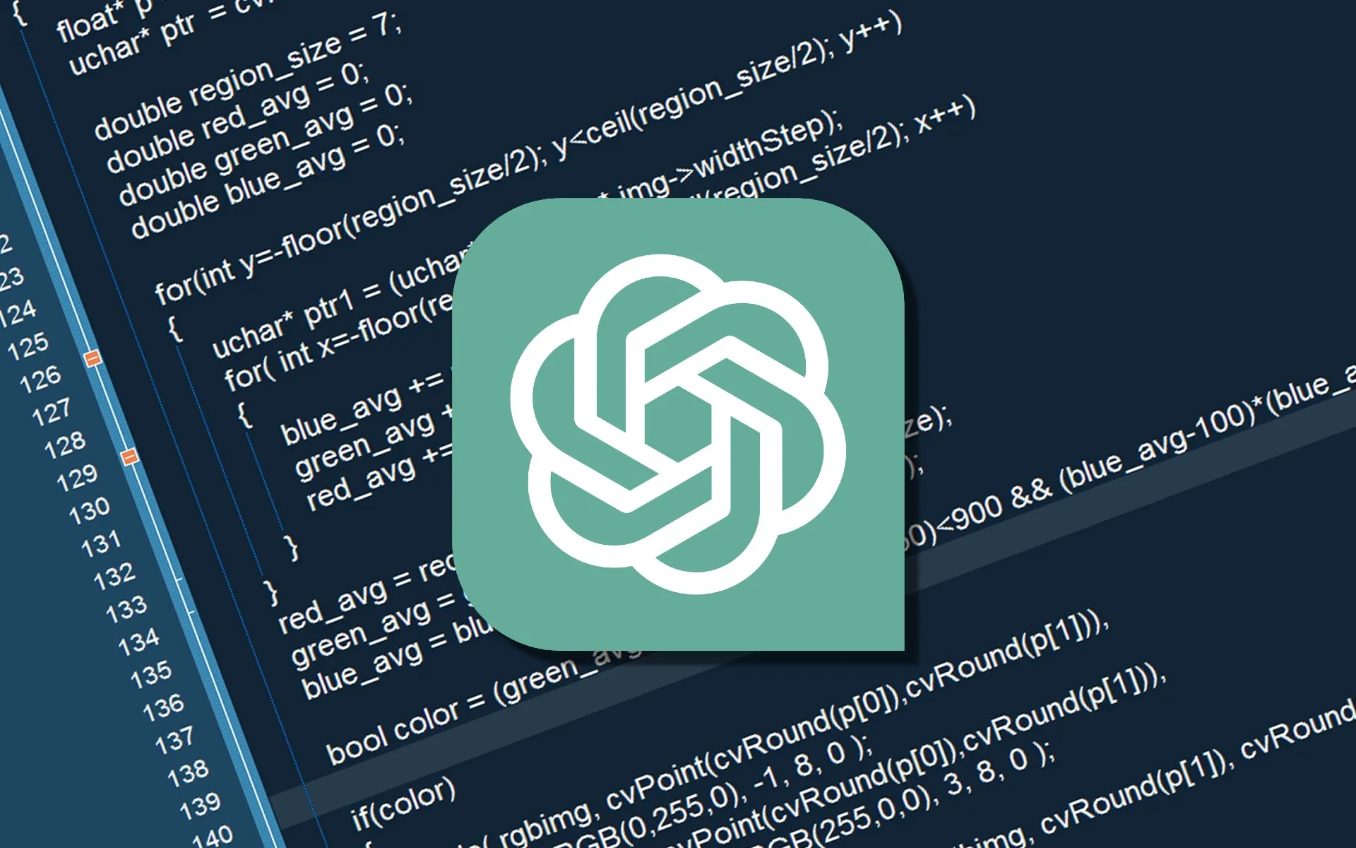
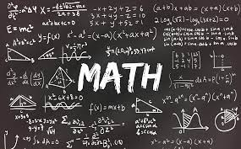
Capabilities of Chat GPT
Creative Writing
Educational Support
It can help with learning and educational queries, providing explanations and information on various subjects.
It can generate creative writing, such as stories, poems, and creative content.
Coding Assistance
Maths Assistance
ChatGPT can assist with coding-related questions, offer code snippets, and explain programming concepts.
It can solve mathematical problems, equations, and provide explanations of mathematical concepts.

Slide 10
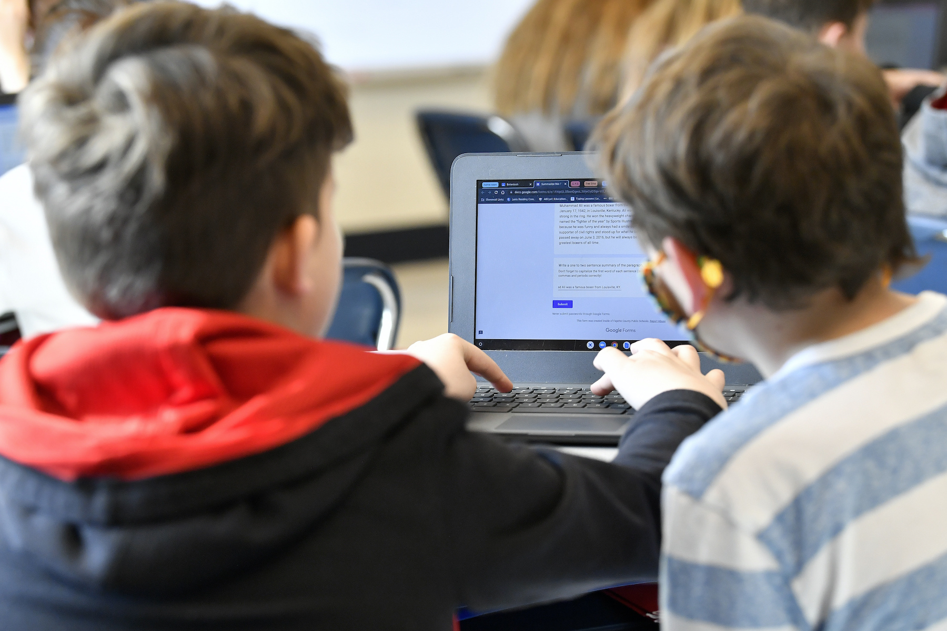
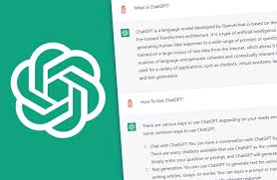
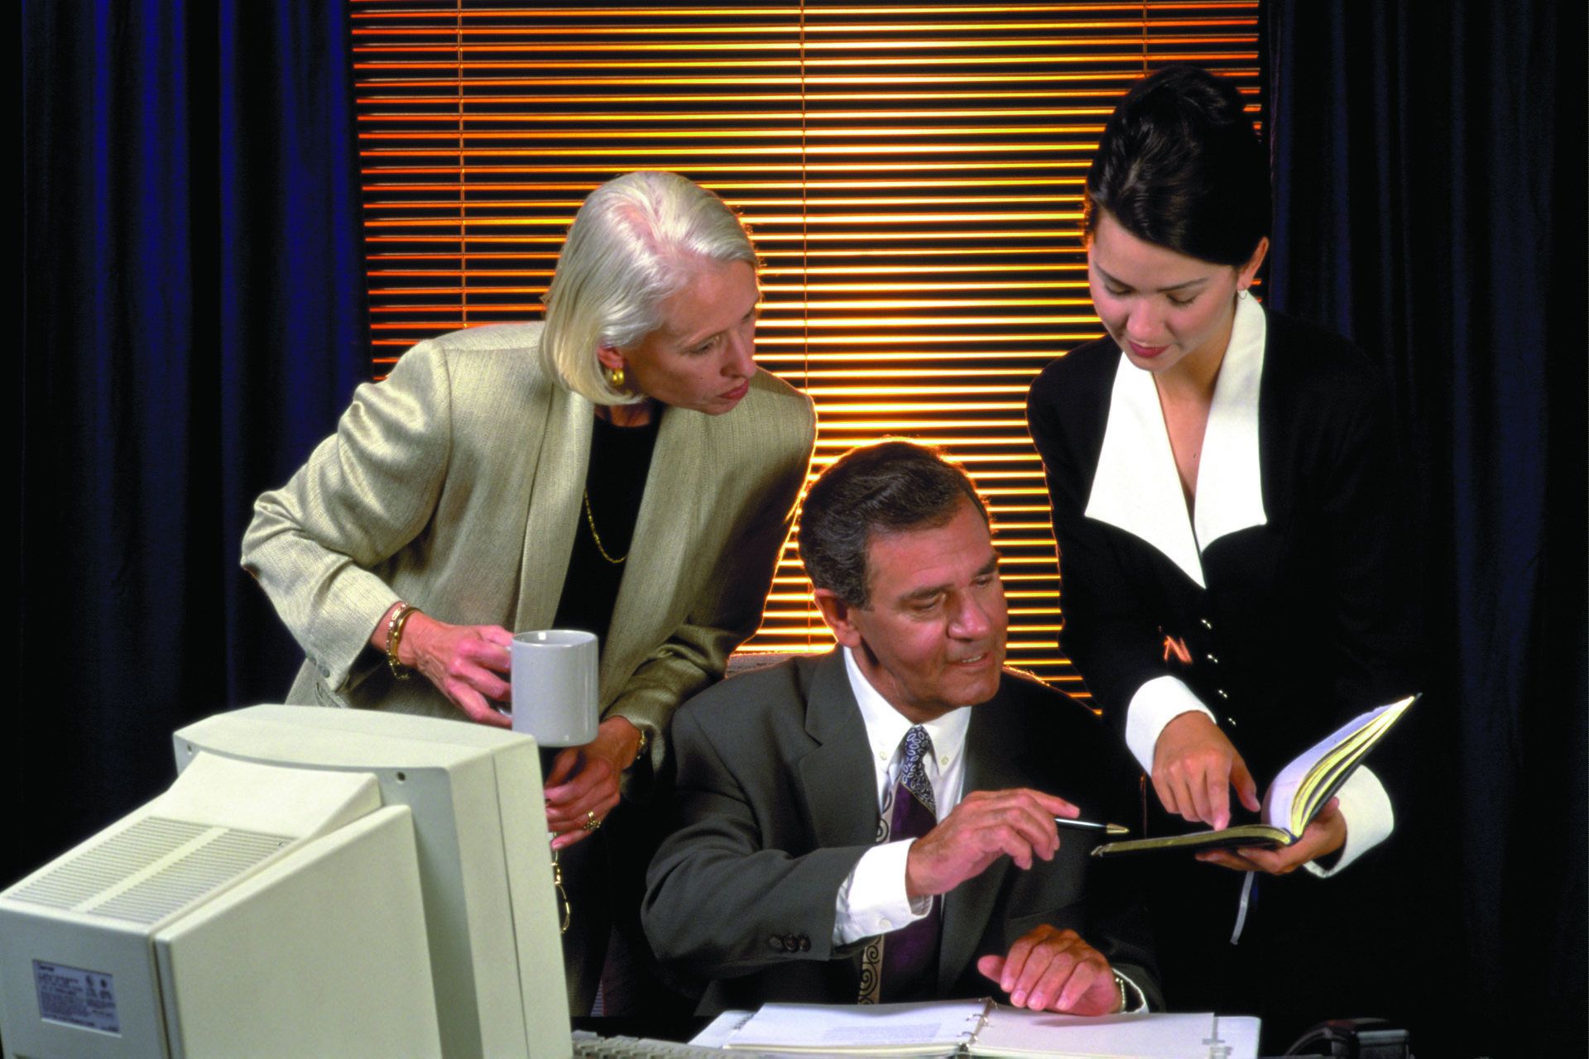
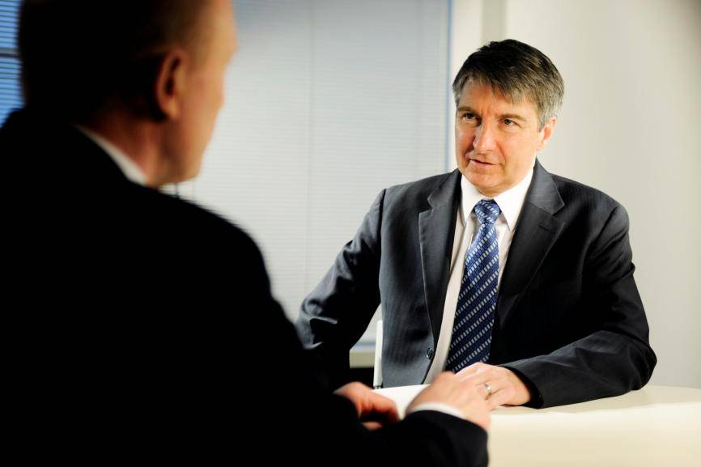
Capabilities of Chat GPT
Educational Support
Text Generation
ChatGPT can generate human-like text based on the prompts and questions it receives. It's capable of carrying on conversations, answering questions, and providing explanations.
It can help with learning and educational queries, providing explanations and information on various subjects.
Text Summarization
Information Retrieval
ChatGPT can summarize long pieces of text into shorter, coherent summaries.
It can provide information from its training data up until its knowledge cutoff date in September 2021.

Slide 11
ChatGPT, like other AI language models, has several limitations
Lack of Real-Time Information
Scripted Responses
06
01
Inappropriate Content
Tendency to Generate Plausible-Sounding but False Information
05
02
04
03
Sensitivity to Input Wording
Inaccurate Information

Slide 12
Current Condition

Slide 14


Slide 15
Feature of Chat GPT

Slide 16
Auto-GPT: A Next-Generation AI Tool on
Auto-GPT is a new version of ChatGPT developed by Significant Gravitas that uses the GPT-4 API to carry out tasks on its own without input by the user.
Instead, the user can simply set a goal for it, and it completes the task for the user by generating its prompts.

Slide 17

Conclusion
Chat GPT and its successors continue to revolutionize how we interact with AI, offering vast potential in numerous fields.
In today's rapidly evolving digital landscape, communication has taken on new dimensions. Chat GPT represents a remarkable leap in the field of natural language processing and artificial intelligence.

Slide 18
References
1
https://zapier.com/blog
2
https://openai.com/blog/chatgpt
3
https://emerline.com/blog/chat-gpt-in-business
4
https://www.resumebuilder.com (Graph Refrence)

Slide 19
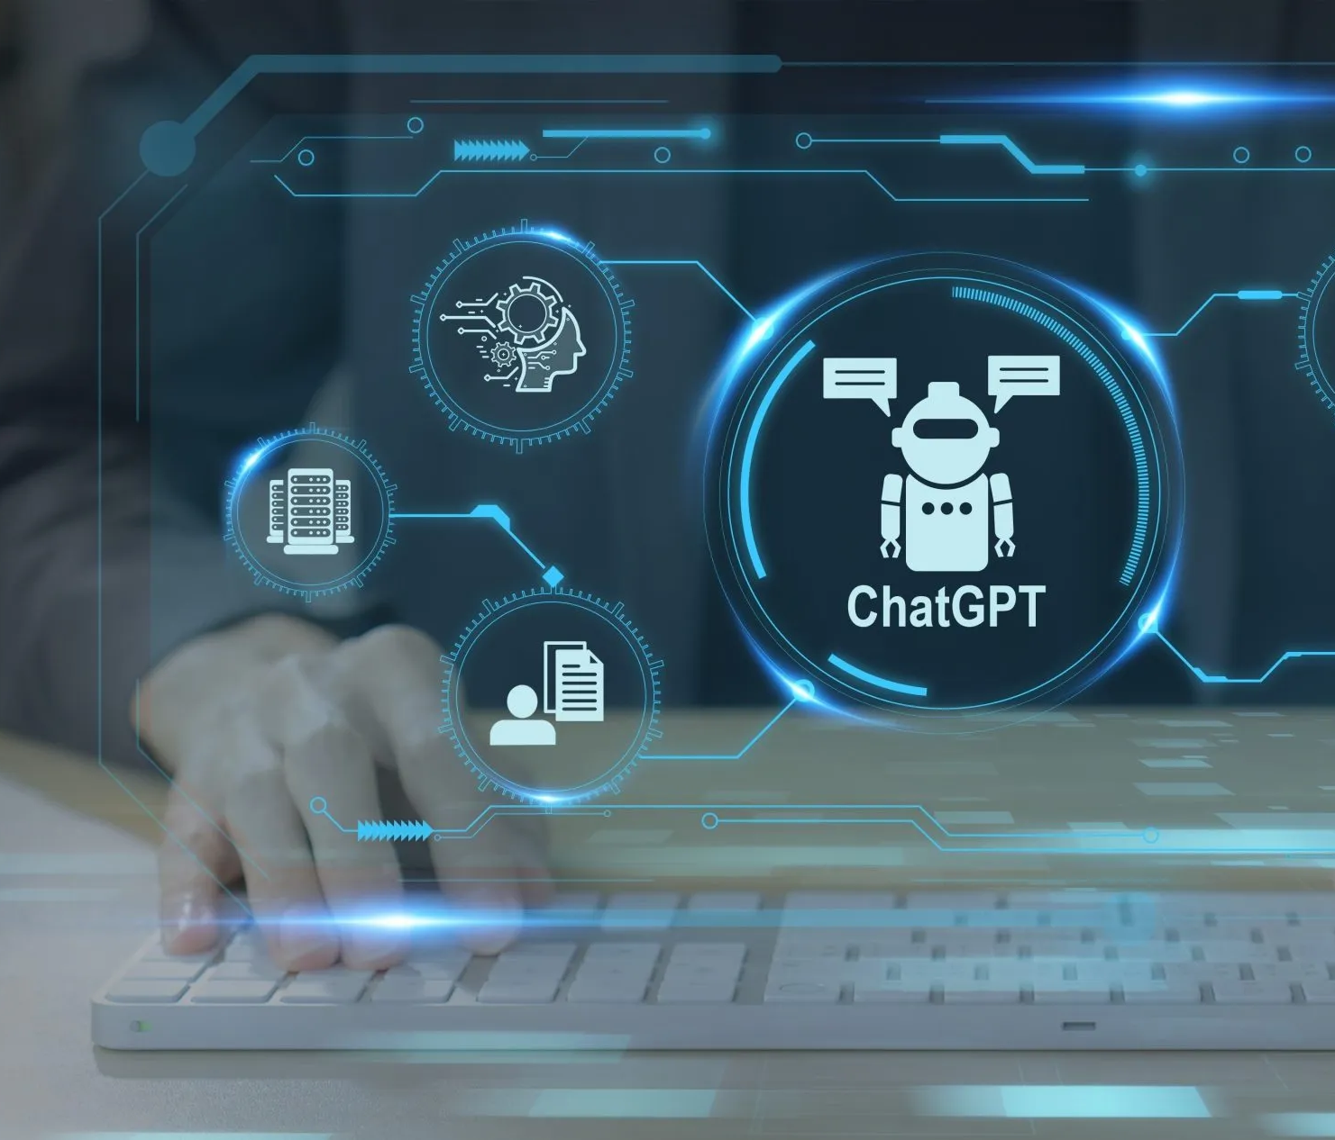
THANK YOU!
Sandesh Gajendra Pol
Phone:
9067248106
Email:
sandeshpol268@gmail.com

